Slide 1

Robotics Operating System(ROS)
Bhaskar Jyoti Bordoloi (1815015)
Md Sarwar Ahmed (1814006)
Kimtiraj Handique (1816014)

Slide 2
What is ROS?
1

Slide 3
ROS is huge
ROS is an open-source, meta-operating system for humanoid robots

Slide 4
Why ROS?
Research development:
Fast prototyping easier in a simulated world.
Lots of packages for sensing, movement, path planning etc.
Error free environment for debugging
Break bits, not real hardware
Transferring from simulated robot to real robot takes a bit of effort, but works!
Notes:
Not really an operating system: really a set of tools
message passing infrastructure:
ROS is used to connect the various nodes that make up your typical robotic system
debugging tools:
ROS CLI (rosnode, rostopic, rosmsg, etc.), rqt_graph
visualization:
RVIZ, Gazebo, tf

Slide 5
What can ROS do?
Hardware abstraction
Low-level device control
Message passing between nodes
Sophisticated build environment
Libraries
Debugging and Visualization Tools
Notes:
Not really an operating system: really a set of tools
message passing infrastructure:
ROS is used to connect the various nodes that make up your typical robotic system
debugging tools:
ROS CLI (rosnode, rostopic, rosmsg, etc.), rqt_graph
visualization:
RVIZ, Gazebo, tf

Slide 6
What are the major concepts?
ROS packages
ROS messages
ROS nodes
ROS services
ROS action servers
ROS topics
...and many more!

Slide 7
Packages
ROS software is organized into packages
Each package contains some combination of code, data, and documentation
package_name/
package.xml ← describes the package and it’s dependencies
CMakeLists.txt ← Finds other required packages and messages/services/actions
src/ ← C++, Python code,URDF (source files)
msg/ ← ROS messages defined for our node (for topics)
launch/ ← folder contains .launch files for this package

Slide 8
Building/Running
Catkin is the official build system of ROS
Catkin combines Cmake macros and Python scripts to provide some functionality on top of Cmake’s normal workflow
Run ROS code

Slide 9
ROS Nodes
The ROS framework is component oriented
Each component is called a node
A node is a process
Nodes communicate through topics, services, and actions

Slide 10
Topics
Each node can listen on or publish messages to topics
Built in message types (std_msgs)
User defined messages
Complex.msg
float32 real
float32 imaginary

Slide 11
Services
A node can provide services – synchronous remote procedure calls
Request
Response

Slide 12
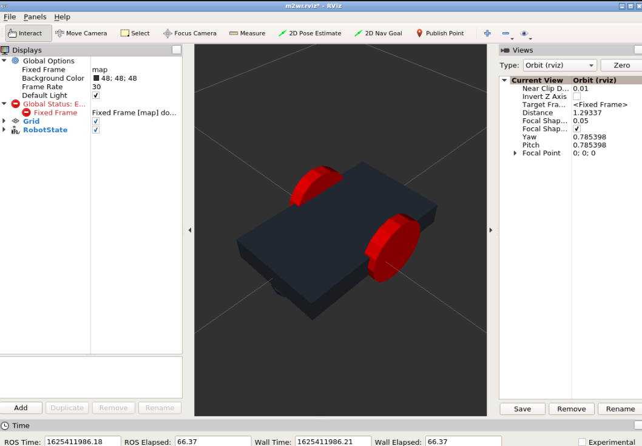
Graphical User Interface
RViz is a 3D Visualization tool for ROS. It is one of the most popular tools for visualization. It takes in a topic as input and visualizes that based on the message type being published. It lets us see the environment from the perspective of the robot.

Slide 13
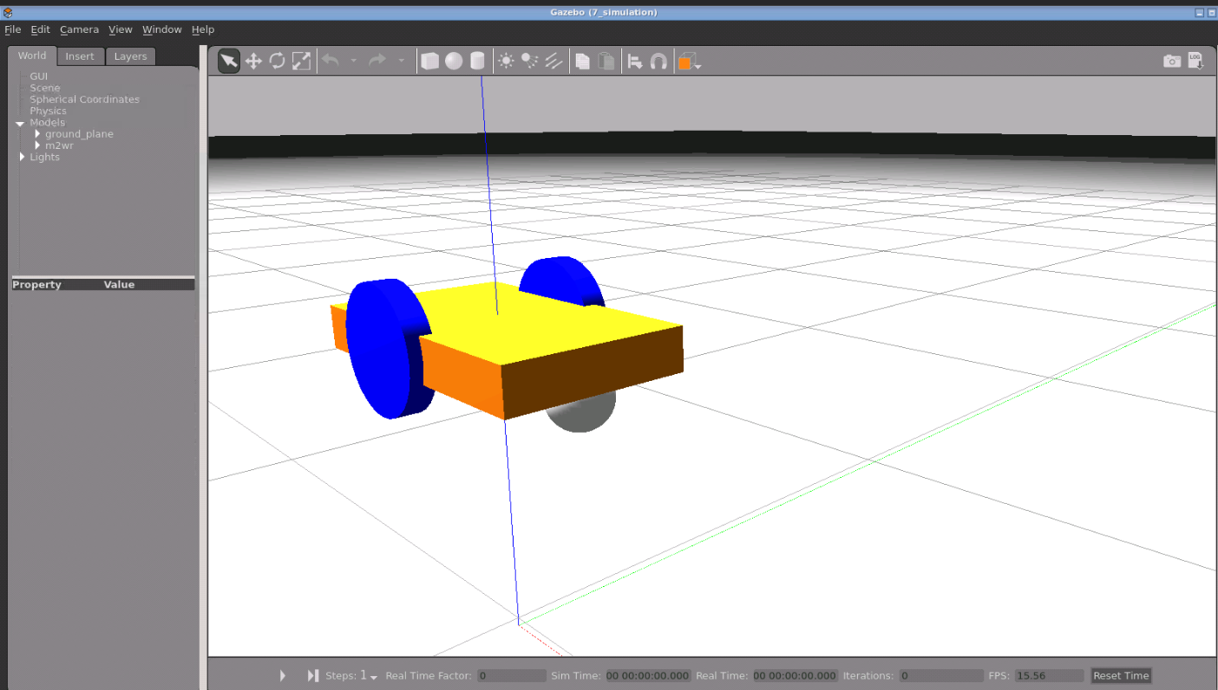
Graphical User Interface
Once we have all the code ready and running, we need to test our code so that we can make changes if necessary. Doing this on a real robot will be costly and may lead to a wastage of time in setting up robot every time. Hence we use robotic simulations for that. The most popular simulator to work with ROS is Gazebo. It has good community support, it is open source and it is easier to deploy robots on it.

Slide 14
Two wheeled Robot using ROS
STEP 1
we are going to use ROSDS (ROS Development Studio). In this first part, we are going to create a robot model, visualize it in RViz and spawn it into a gazebo world.

Slide 15
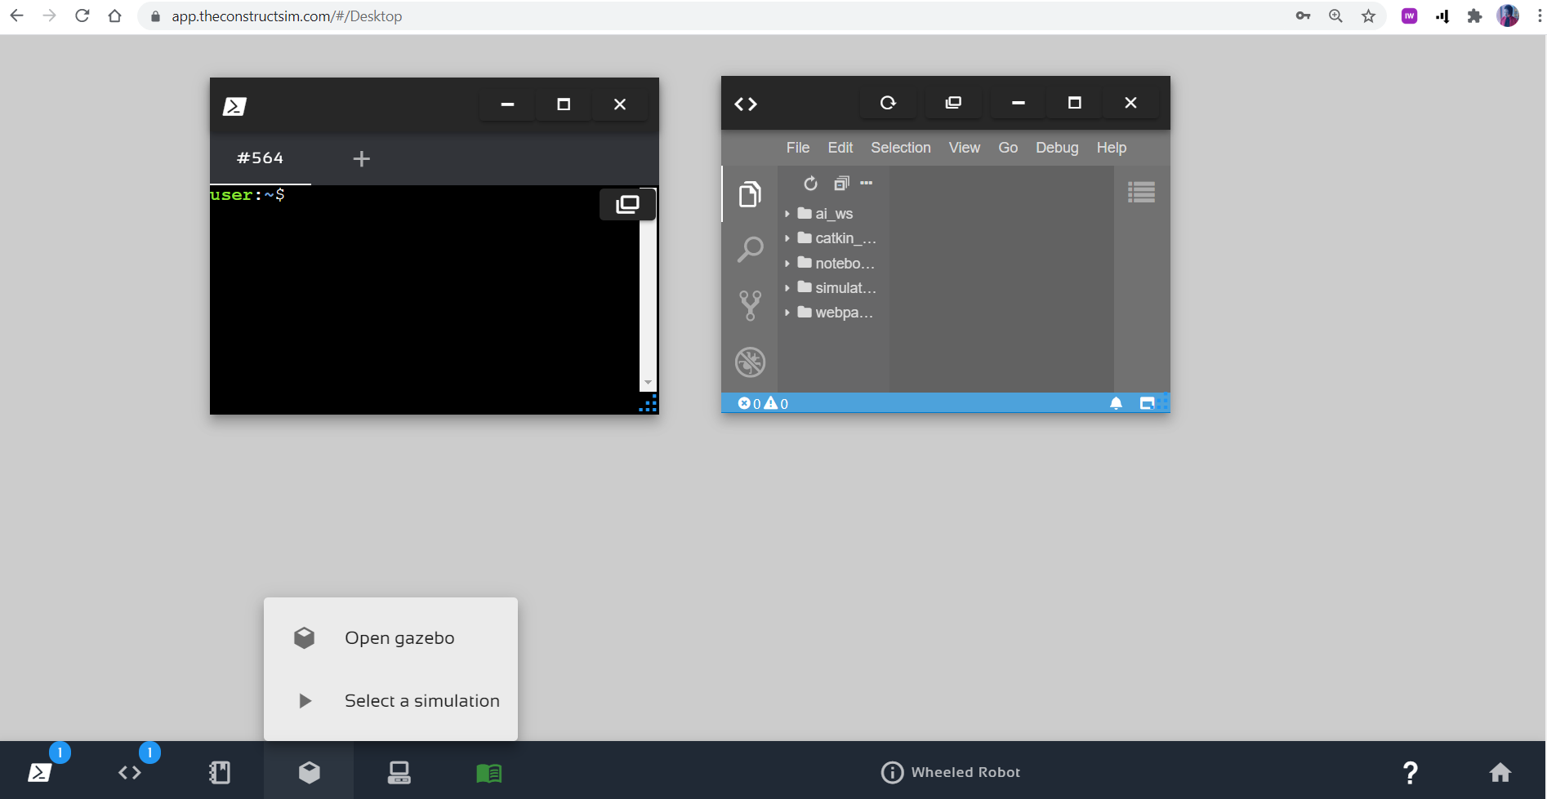
Two wheeled Robot using ROS
That’s our development environment or ROSDS desktop:

Slide 16
Two wheeled Robot using ROS
STEP 2
We creating our package, inside of simulation_ws/src:
user:~$ cd ~/simulation_ws/src user:~$ catkin_create_pkg m2wr_description urdf
The first we are going to do it to create the robot description file. We are using a XACRO file.

Slide 17
Two wheeled Robot using ROS
STEP 3
We create a new folder urdf inside of ~/simulation_ws/src/m2wr_description and write the code of robot description to a new
file: ~/simulation_ws/src/m2wr_description/urdf/m2wr.xacro

Slide 18
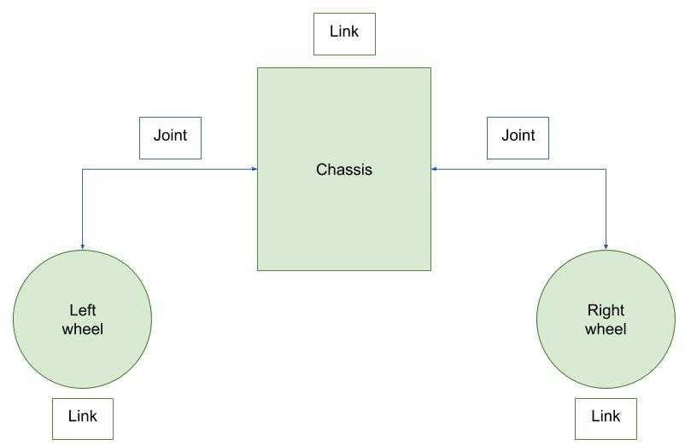
Two wheeled Robot using ROS
What do we have there?
Basically, it’s a robot composed by 3 links and 2 joints. Every robot needs a base link, in this case, the chassis is in charge of connecting all the parts of the robot. Below an image that represents the relation between the links and joints. (Links in green, joints in blue).

Slide 19
Two wheeled Robot using ROS
STEP 4
We have our robot model defined. Now we are going check it in RViz. In order to do that, we create a launch file and that opens RViz and fill its robot visualization with our model.
We create a new folder: ~/simulation_ws/src/m2wr_description/launch/rviz.launch
and then write the code for Rviz launch file.

Slide 20
Two wheeled Robot using ROS
Now,we open a terminal and compile the simulation_ws. (we actually don’t have anything to be compiled, but we need catkin to generate ROS header files, in order to have it into our $ROS_PACKAGE_PATH). After compiling it,we launch the RViz visualization of the robot.
You’ll execute something like:
user:~$ cd ~/simulation_ws user:~/simulation_ws/$ catkin_make user:~/simulation_ws/$ roslaunch m2wr_description rviz.launch
Now, we open the Graphical Tools application:

Slide 21
Rviz: Robot Visualization

Slide 22
Two wheeled Robot using ROS
STEP 5
First, we create a new launch file: ~/simulation_ws/src/m2wr_description/launch/spawn.launch
Stop the last launch file we started (for RViz), we are going to use the same terminal once again.
Finally, we spawn the robot to the Gazebo simulation.
In your terminal, execute the following:
user:~/simulation_ws$ roslaunch m2wr_description spawn.launch

Slide 23
Gazebo Simulator
Notes:
ONE SLIDE FOR PR2 AND BAXTER. ELIMINATE DUPLICATE SLIDES

